Slide 1
Pitch Deck
ticker.watch

Slide 2
About us
ticker.watch is a comprehensive application that helps investors around the world make better investments based on real-time information about companies.

Slide 3
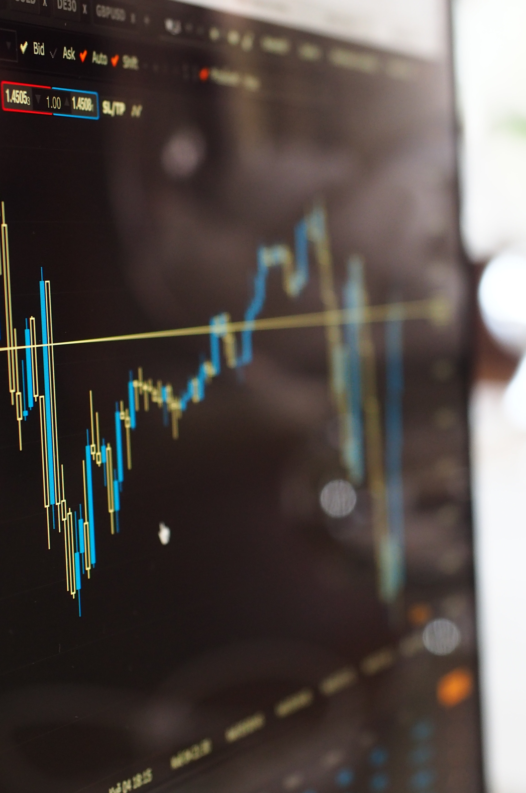
Problem
For institutions
Investors need to find as quickly as possible about financial and non-financial news. Especially in Europe, this can be done by checking a lot of websites.
Common problem
In both cases finding important information requires a lot of time and can have a major impact if it's found too late.
For retail
Competitors have the same details that require time and knowledge to read and understand. An easy to read and understand report related to the company's financial health is needed.

Slide 4
Solution
Up to date platform
Target audience
A modern platform that can integrate with our customer's systems and publish all the events as they happen as well as predictions about future events.
Institutional investors and trading applications
Up to date rating
Target audience
Create a proprietary rating that's updated in real-time based on the latest data and indicates the company's financial health.
Retail investors who want an accurate overview of a company's financial health without reading all the financial documents.

Slide 5


Product Key differentia
Automate
First to market
Our product will automate labor-intensive tasks to let people focus on decision making.
First beautifully designed product that presents only curated data for every investor.

Slide 6
Growth strategy
How we’ll scale in the future​
2024
2025
Release the first version with essential events and information for all US and European stock exchanges.
Release a comprehensive platform adequate for retail and institutions.

Slide 7
Thank you
Posea Lucian​​
lucian.posea@ticker-watch.com
ticker.watch​

